Slide 1
Pathrise Project Data Roadmap Final Assignment
DataTigers

Slide 2
Project analysis slide 4
Project Analysis
Select appropriate modeling techniques based on the problem at hand
Modeling
Identify and understand the business problem or objective you are trying to solve
Business Understanding
Assess the performance of the models using relevant evaluation metrics
Data Preparation
Data Exploration
Evaluation
Collect and gather the relevant data sources that are required to solve the problem
Data Understanding
Clean and preprocess the data by addressing missing values, handling outliers, and dealing with inconsistencies.
Perform exploratory data analysis (EDA) to gain insights into the data distribution, patterns, and relationships
Implement the chosen model into a real-world environment, if applicable
Deployment

Slide 3
Project analysis slide 5
Pathrise Company
Land Your Dream Job
Our mentors help you get more interviews and ace them for
top companies like Google, Amazon, McKinsey and more.
We've helped 2,250+ fellows of all sorts of backgrounds land great jobs
A: Mentorship: Pathrise connects participants with experienced mentors who have expertise in the tech industry. These mentors provide personalized guidance, advice, and support throughout the job search process.
B: Project Work: In addition to the curriculum,
participants might work on real-world
projects to gain practical experience and build their portfolios.
C: Networking: Pathrise emphasizes the importance of networking in the job search process. Participants are encouraged to build their professional networks by connecting with industry professionals, attending events, and leveraging online platforms.

Slide 4
Project analysis slide 6
Pathrise Project
This initiative involves both a classic classification challenge and a regression aspect. Based on historical data regarding individuals who participated in Pathrise's program, the project encompasses two primary goals:
1. Preparing a model to predict whether people would find a job or not ?
2. Preparing a model to predict how long does it take to find a job?

Slide 5
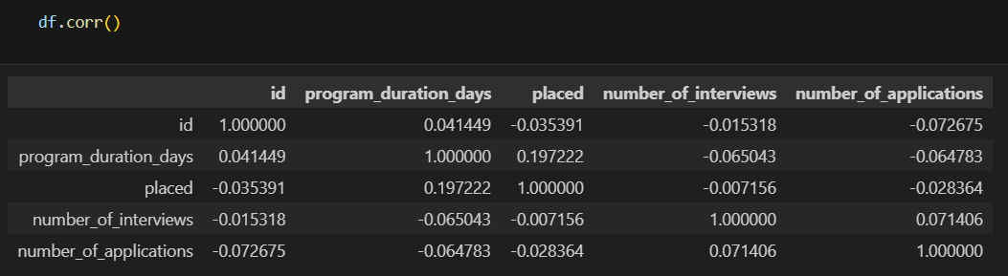
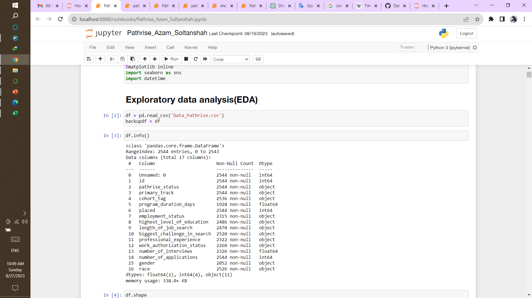
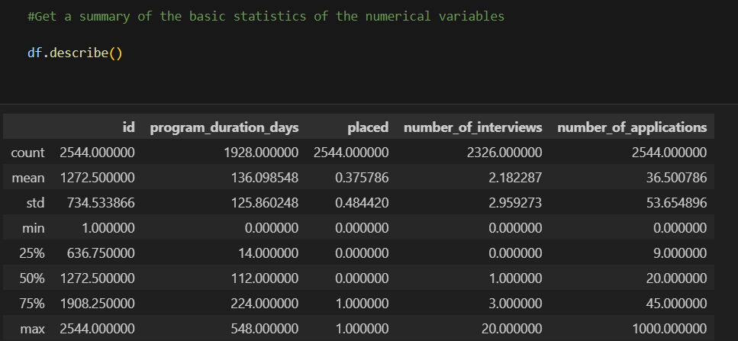
Data Collection
In this project which we receive it from Pathrise Campony as an Excel file.
Data has 2544 rows and 16 columns
As you can see there are sum informations here.
Missing Values
Object
Float64
Description of numeric columns

Slide 6
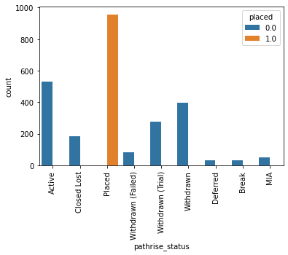
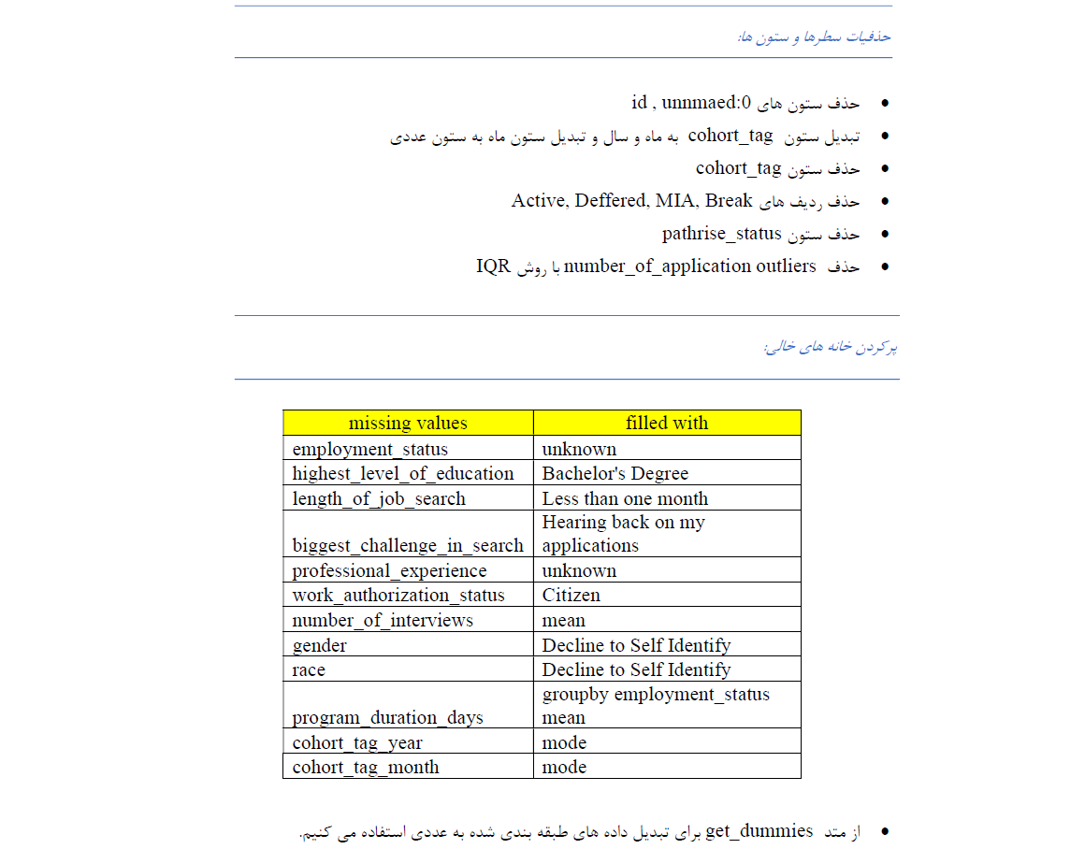
Data Wrangling
pathrise_status | status of a fellow in the program
Active | currently in the program
Break | on a temporary break
Closed Lost | didn't accept our offer
Deferred | accepted our offer, but willing to start later
MIA | missed in action - joined the program, but stopped being involved
Placed | got placed through our program
Withdrawn | got withdrawn due to not being active or for some other reason
Withdrawn (Failed) | got withdrawn due to not finding a job after one year of going through the program
Withdrawn (Trial) | didn't stay in the program after a free trial period

Slide 7
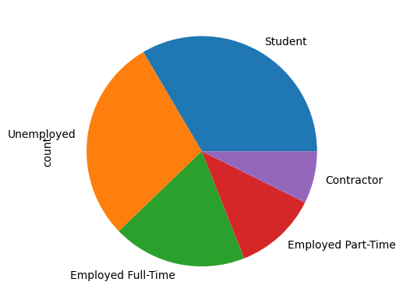
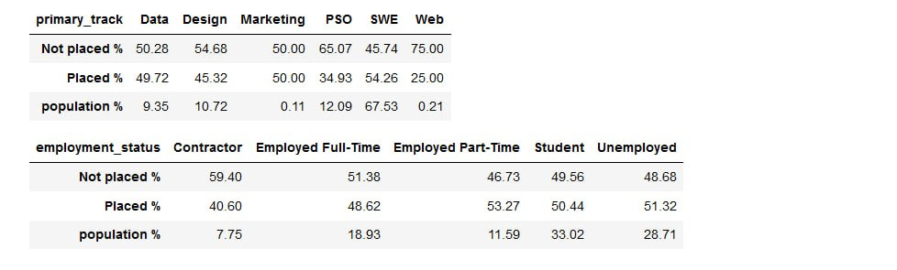








Exploratory Data Analysis
Employment status
Which demographic or group of individuals
had a greater likelihood of finding
a successful career?
Primary track
A) Among the primary tracks,
which one has a higher population?
B) Which primary track tends to
lead to better job prospects compared to others?

Slide 8
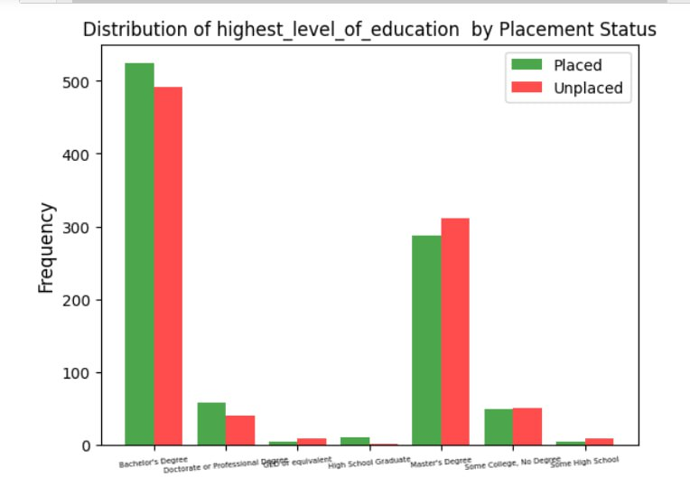
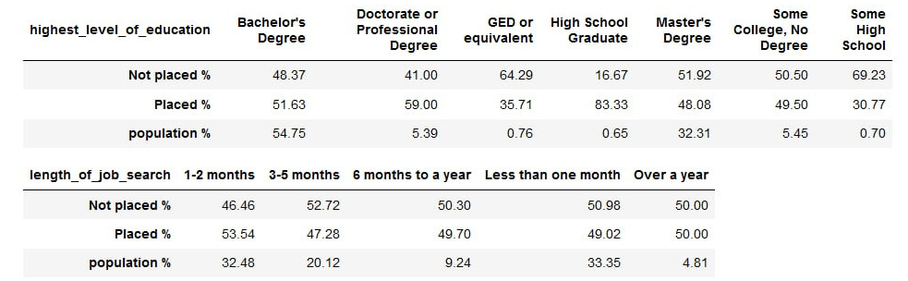









Exploratory Data Analysis
Level of Education
Length of job search
How do these two factors contribute to assisting
individuals in securing employment?
which degree has the more chance of getting placed?
How long have they been looking for a job?

Slide 9
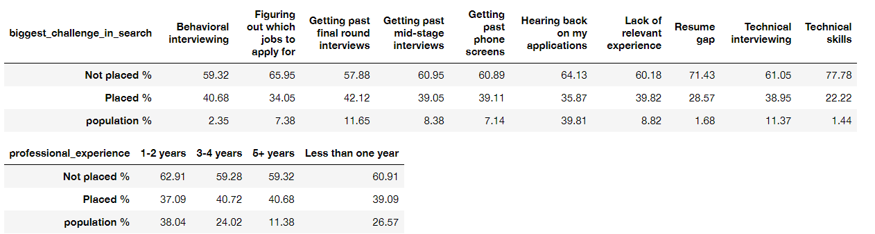
Exploratory Data Analysis
Biggest challenge
Professional experience
Resume gap and Technical skills have least percentage of placement.
Most of clients have 1-2 years of experience.
Is the professional experience useful?

Slide 10
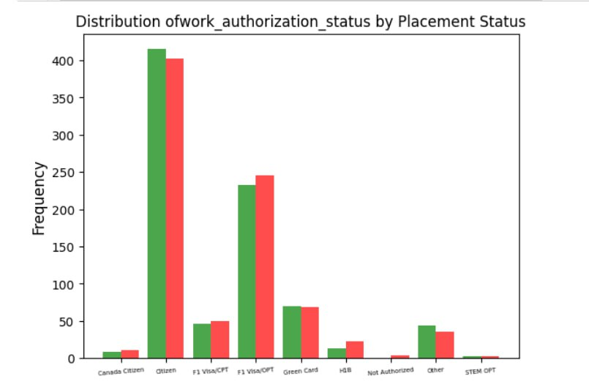
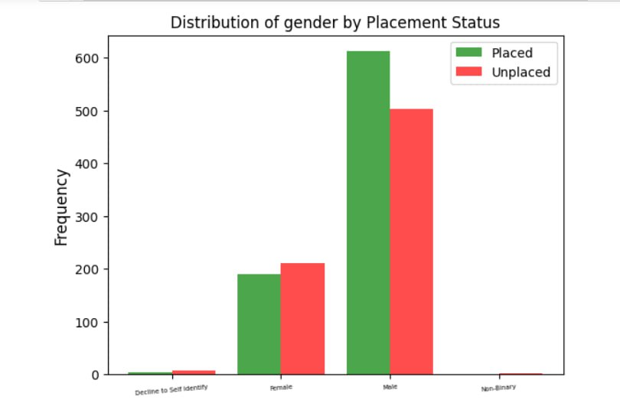
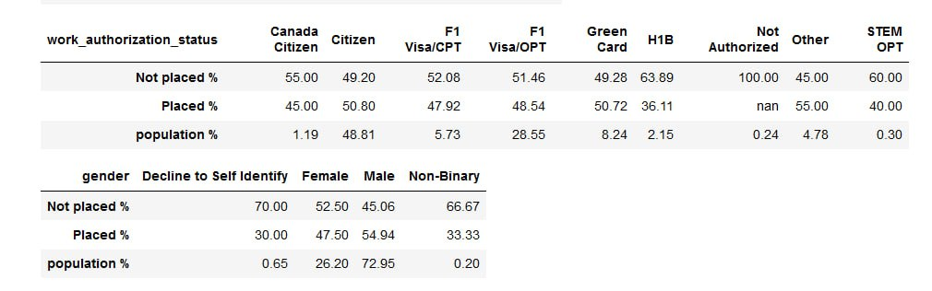






Exploratory Data Analysis
-Work authorization
-Gender
Are you American or Not?
Who is the winner? Male or FEMALE

Slide 11
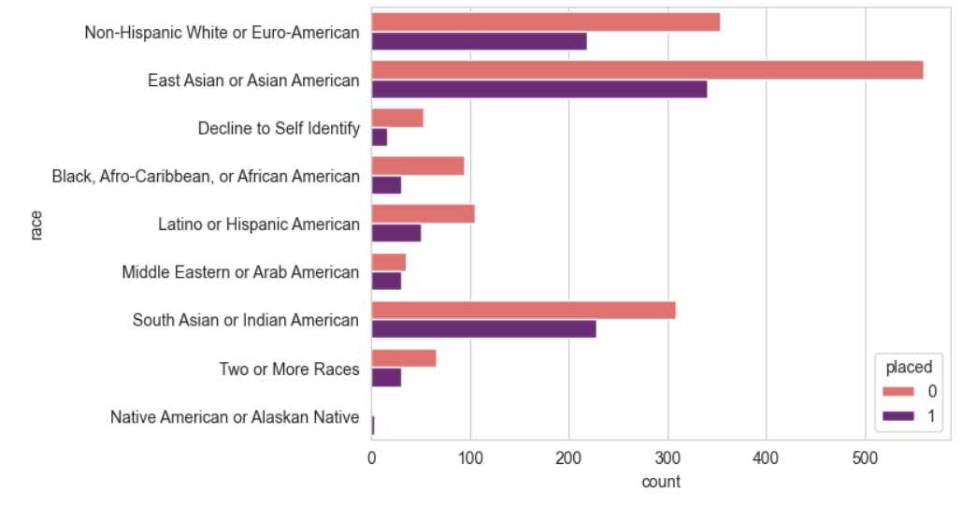
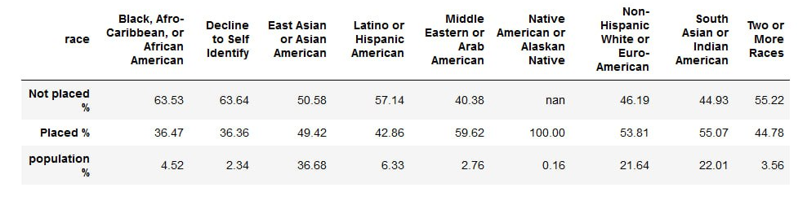



Exploratory Data Analysis
Does Race Matter?

Slide 12
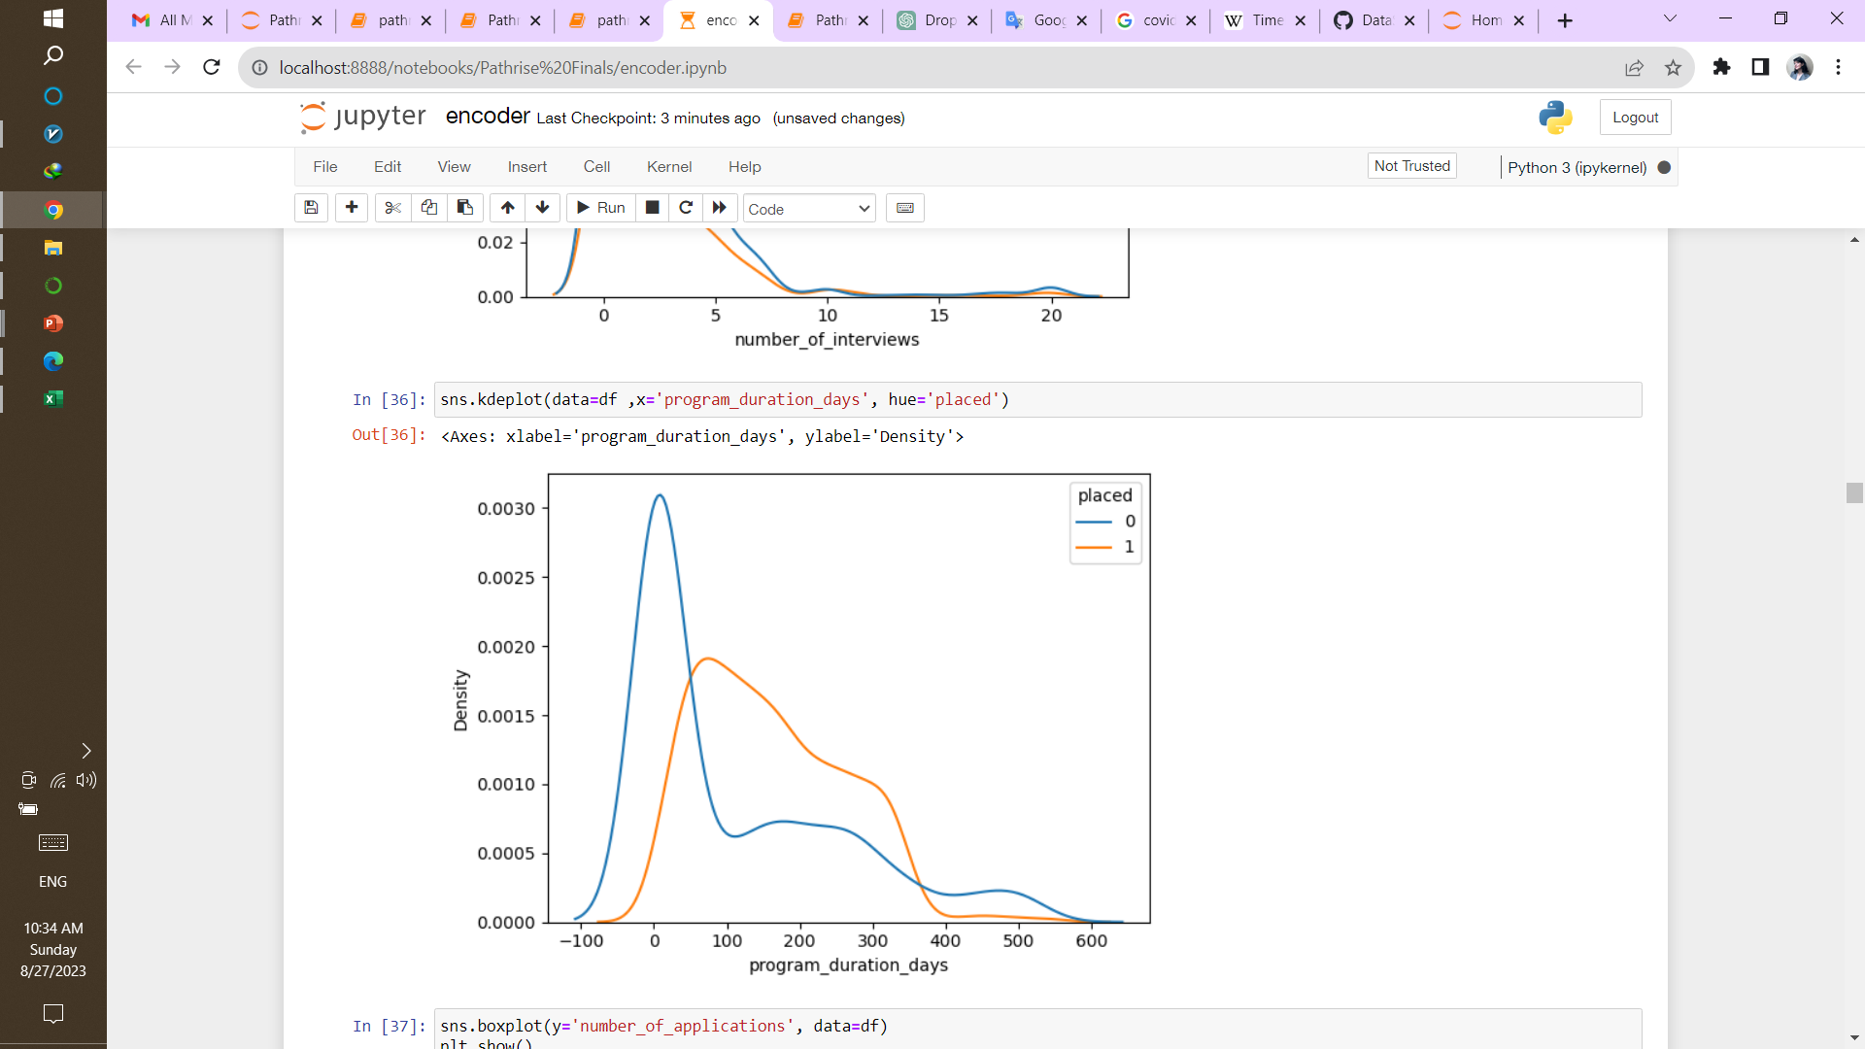
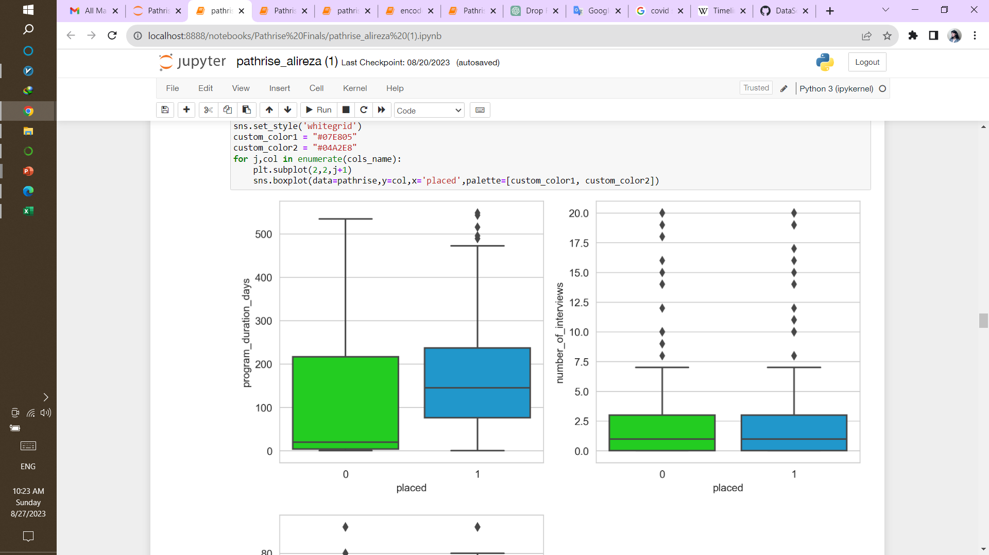
Exploratory Data Analysis
Program Duration Days
~85 days
JAN |  |  |  | JAN |  |  |  | JAN |  |  |  | JAN |  | OCT
2018 |  |  |  | 2019 |  |  |  | 2020 |  |  |  | 2021 |  | 2021
Covid 19

Slide 13

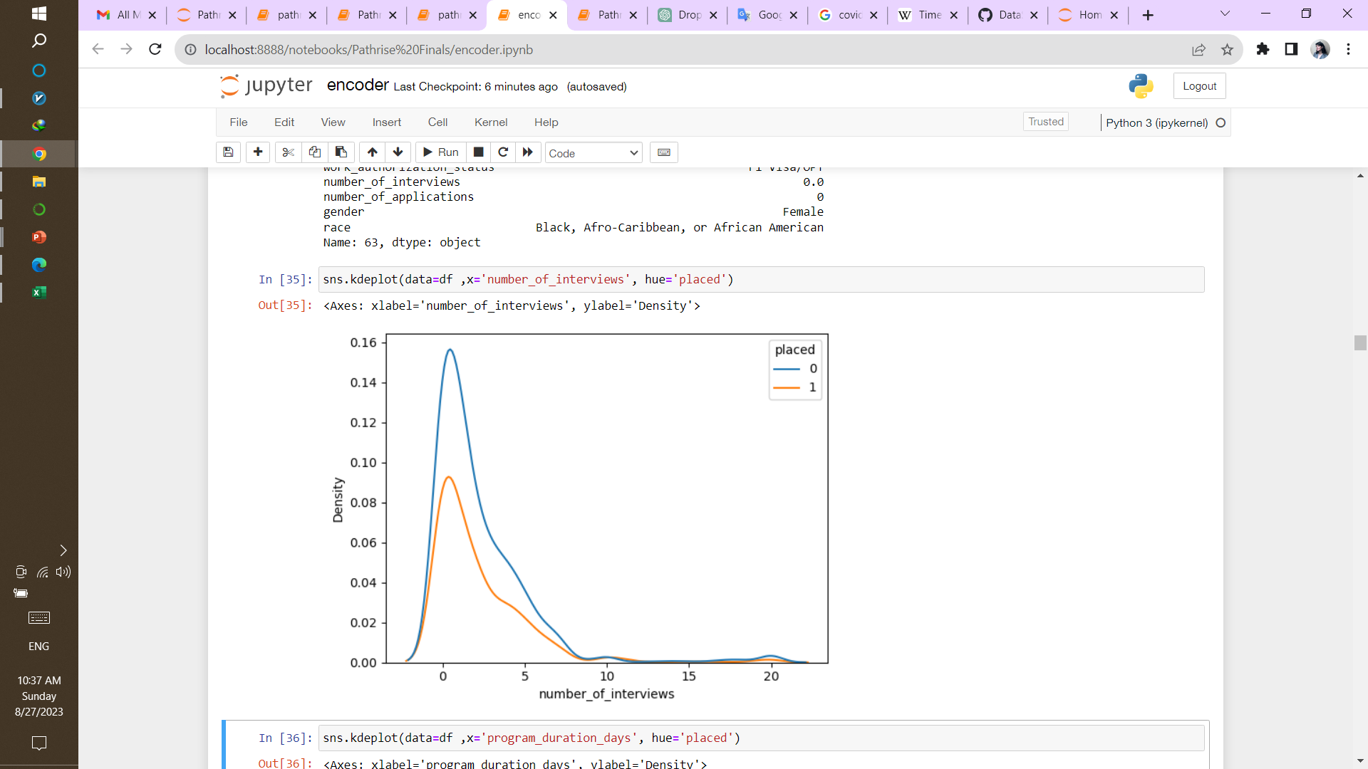
Exploratory Data Analysis
Number of interviews

Slide 14
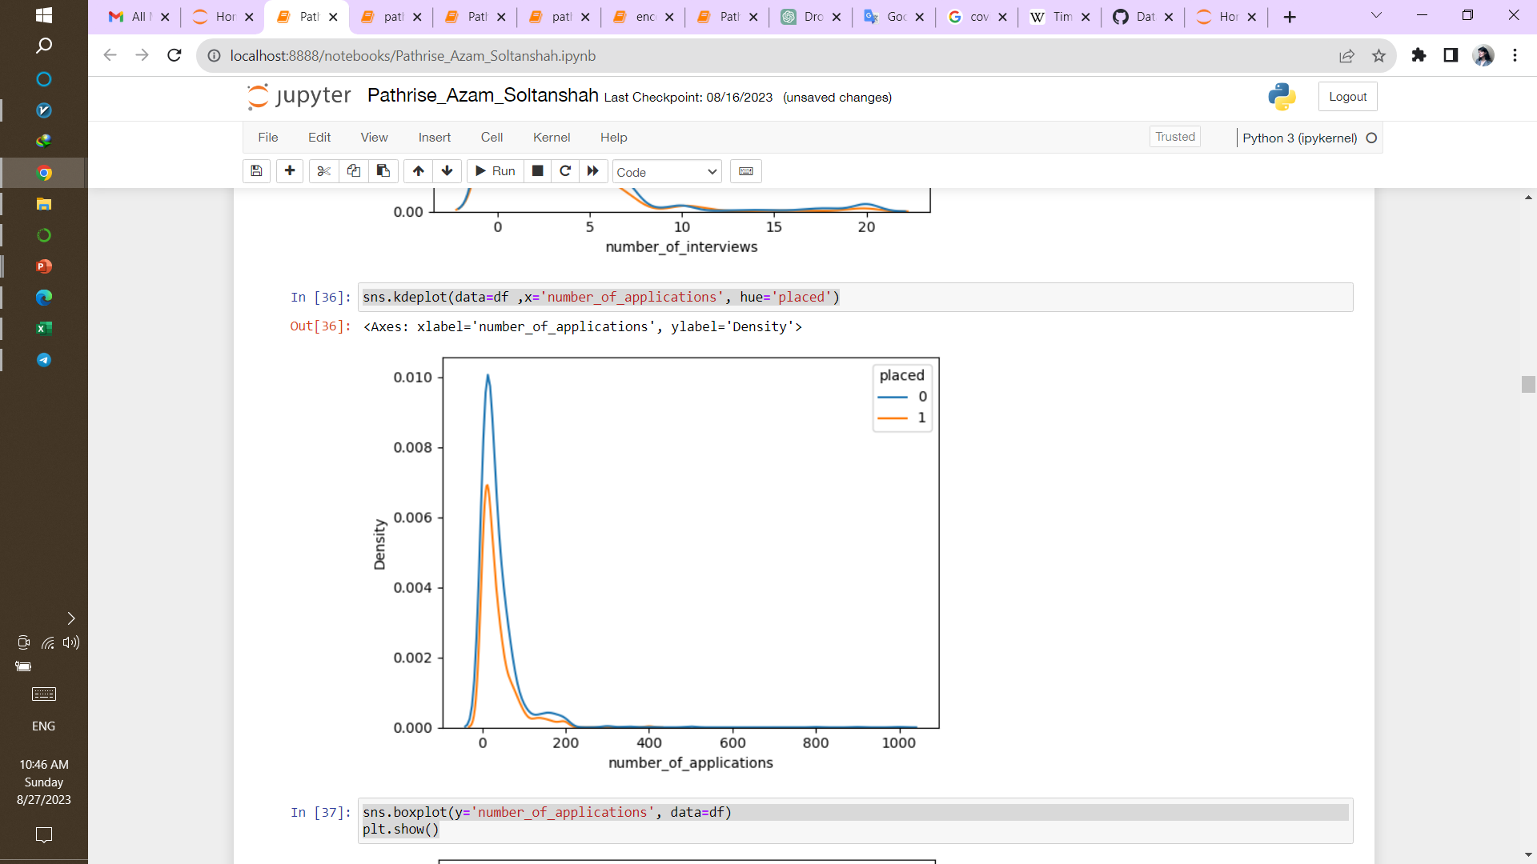
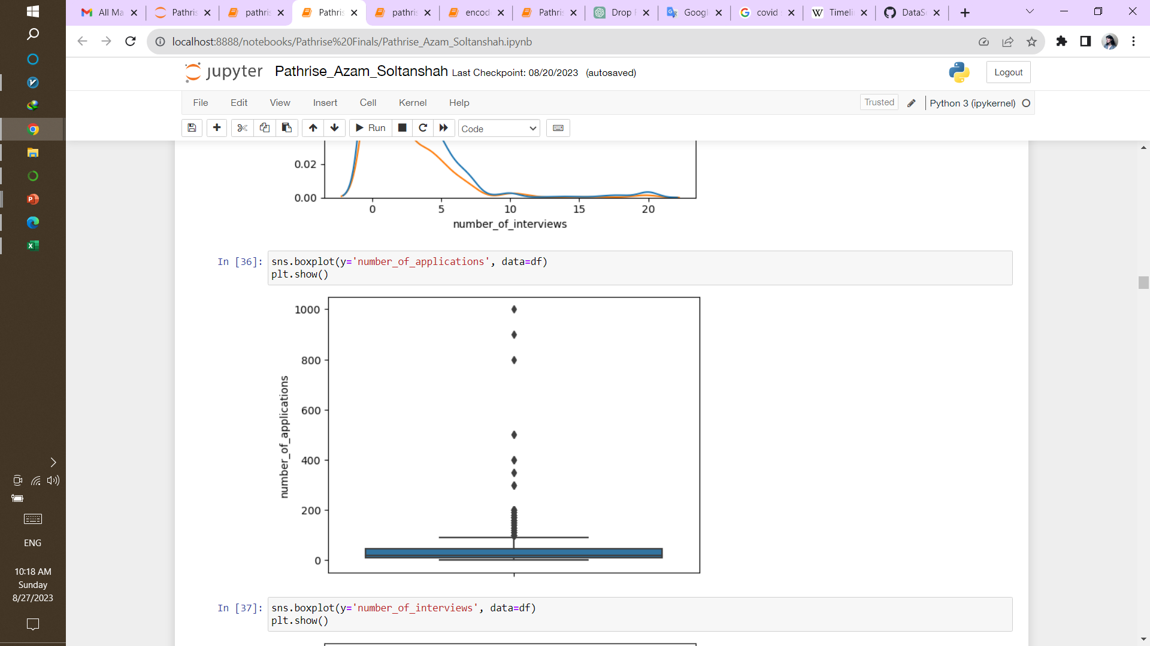
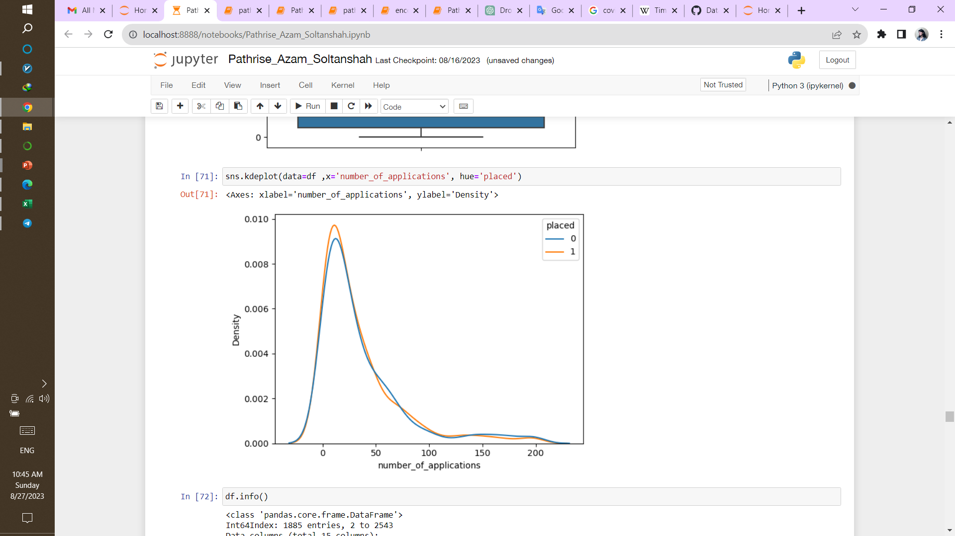
Exploratory Data Analysis
Number of applications

Slide 15
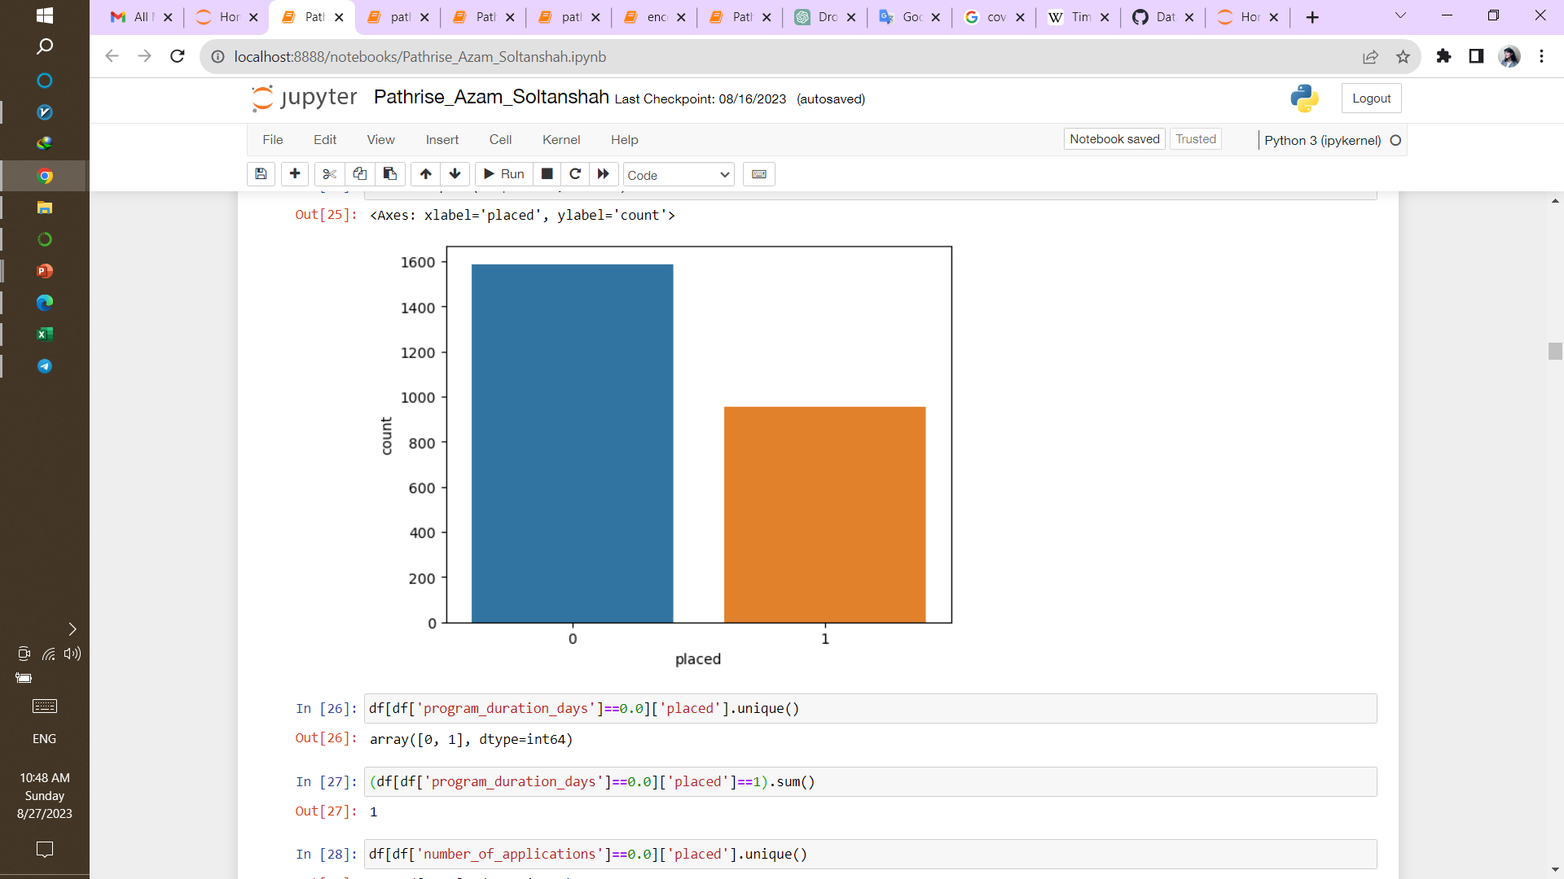
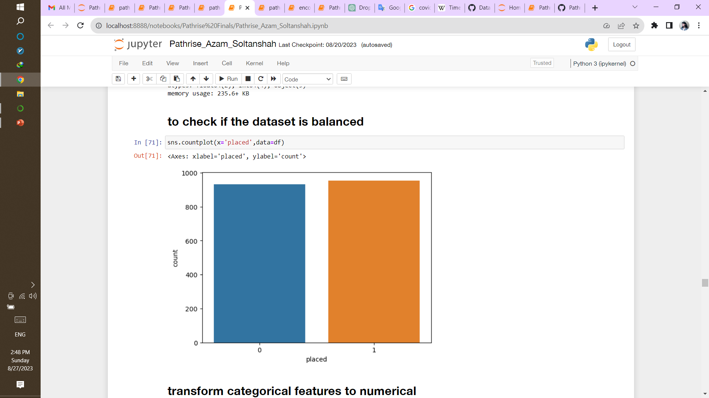
Ballenced and prepared data
Unbalanced dataset before preproccesing
Now we have a scaled and balanced dataset
Range Index = 1885
Columns = 67
Placed or not placed are almost equal

Slide 16
Machine Learning
Now, it’s the time to answer the questions and test our data,
1) Does it can predict well or not?
2) Is it acceptable or not?
3) Which machine is better than others?
Creating a predictive model for determining the success of an individual in
securing a job while participating in the Pathrise program.
We used supervised classification machine learning.
What’s the results?
Who knows?

Slide 17
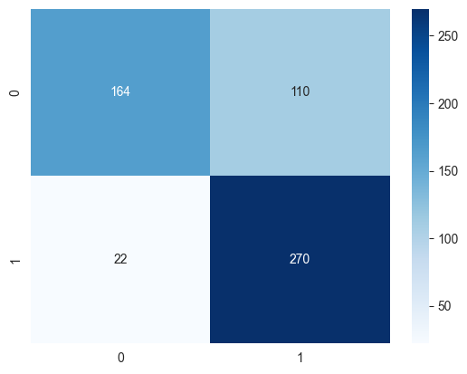
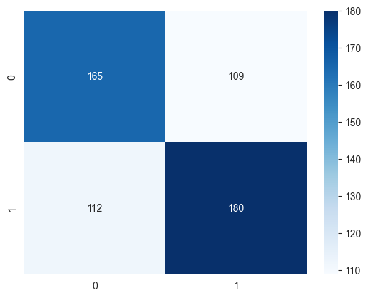
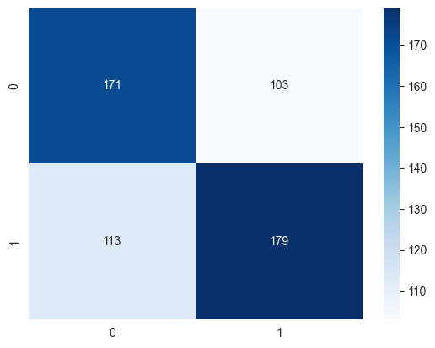
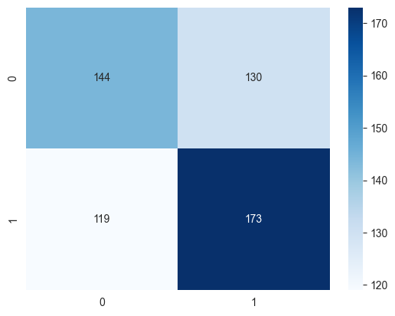
Machine Learning
Decision Tree
Logistic Regression
SVM
KNN

Slide 18

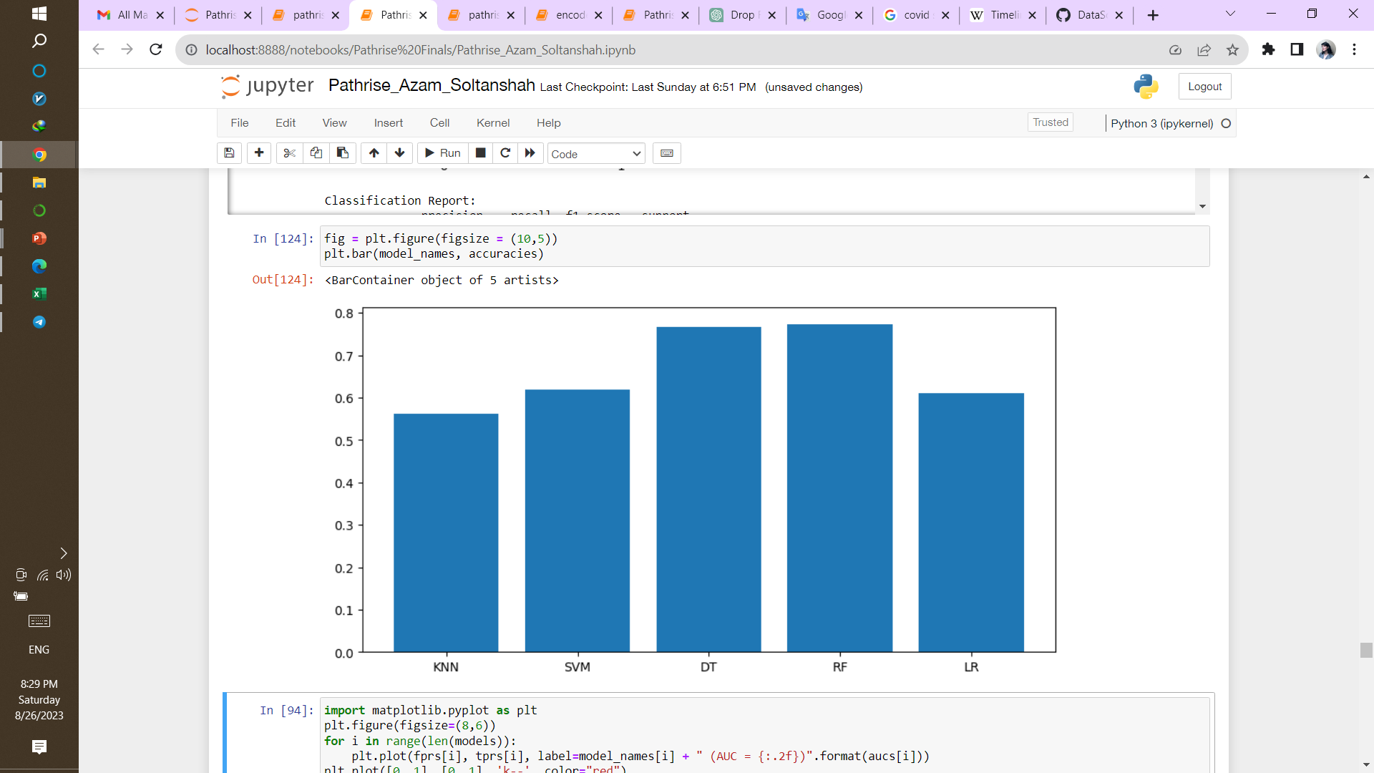
Classification results
TP + TN
Random Forest
TN → FP
 | Logistic Regression | Support Vector Machine | Decision Tree Classifier | K Nearest Neighbor | Random Forest
precision | 0.62 | 0.63 | 0.71 | 0.57 | 0.72
recall | 0.62 | 0.61 | 0.92 | 0.59 | 0.91
f1-score | 0.62 | 0.62 | 0.80 | 0.58 | 0.81
accuracy | 0.61 | 0.62 | 0.76 | 0.56 | 0.77

Slide 19
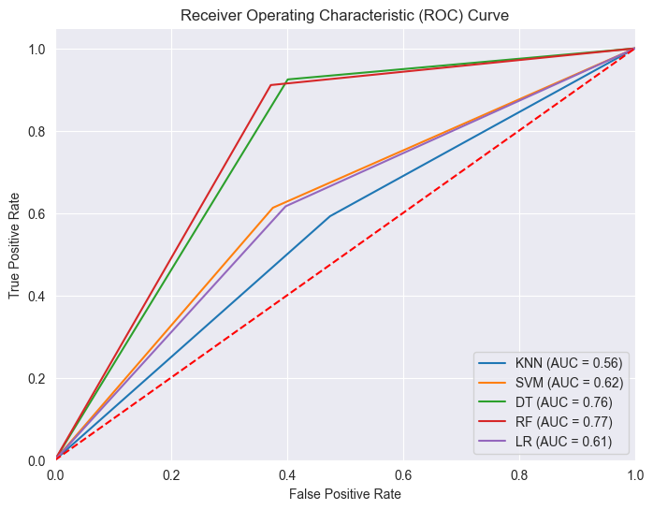
Classification results

Slide 20
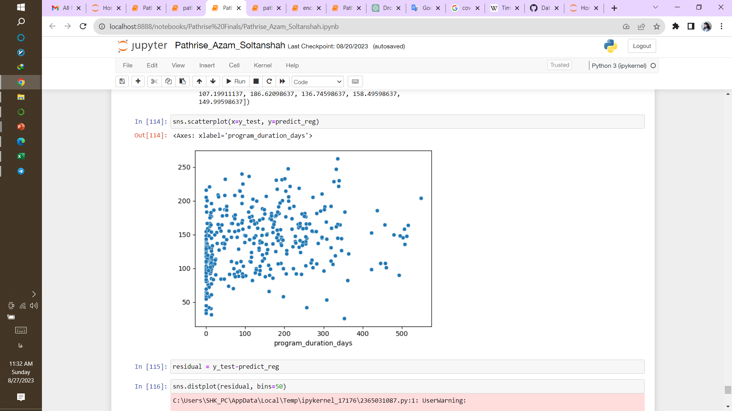
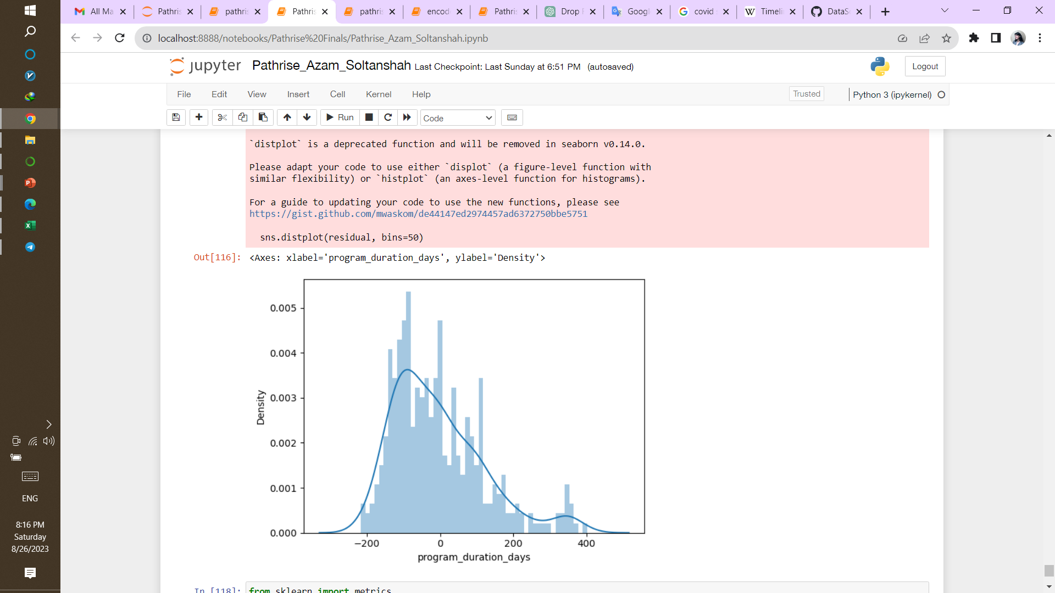
Linear Regression
~85 days
 | Linear Regression
MAE | 98.3
MSE | 15359.8
RMSE | 123.9

Slide 21
Recommendations
Primary Trac | The company should prioritize Software Engineering, Data, and Design as the target groups for customer attraction.
Employment Status | student and unemployment are more likely to join pathrise program in order to find a job and they have shown the highest percentage of successful placements so these can be good choices as potential clients
Biggest challenge in search | most of the clients mentioned hearing back from my application as their biggest challange but we can see company has better success rate in Getting past final round interviews and in other aspect has almost equal performance .Except for technical skills and resume gap.
Professional experience | Most of clients have 1-2 year exprience, but we see people with 3+ year experience have more chance to get placed
Work authorization status | most of the participants are citizens (48.91%), we can see all kind of authorizations have successful rate between 34 to 39 % except for STEM OPT and H1B which are less likely to get a job. Pathrise should consider work authorization as a factor to get clients.
Gender | 72.7% of participants are male, and the male gender also has the highest percentage of placements. However, in order to avoid any gender bias, the company does not intend to exclusively target males for client attraction.
Race | 35.4% of participants are East Asian or Asian American with 38% of getting placed. But as we see 100 % of Native American or Alaskan Native have gotten placed. Even if Black, Afro-Caribbean, or African American just 5% of the population their chance of getting placed are less than any other races.

Slide 22
Thank You

